Slide 1
Object Oriented Programming
Object oriented programming
Spring 2024

Slide 2
Software industry
Large commercial software are composed of thousands of lines to manage complexity
Following techniques are used
Procedure Oriented approach
Object Oriented approach

Slide 3
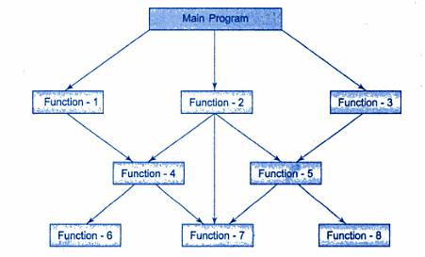
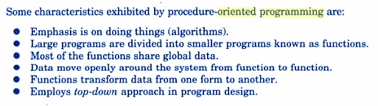
Procedure-oriented Approach

Slide 4
Drawbacks of Procedure oriented Approach
Uses global data
More vulnerable to an inadvertent change by a function
In large programs, it is very difficult to identify what data is used by which function. In this case we need to revise an external data structure, we also need to revise all functions that access that data
Difficult for maintenance , upgrading or modification
It does not model real world problems very well

Slide 5

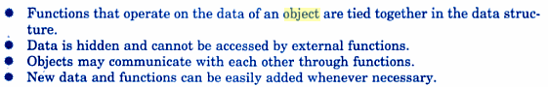
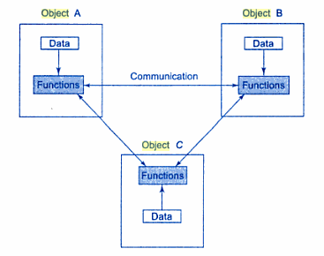
Object Oriented Approach

Slide 6
Example of an organization
An organization contains three departments
Accounts
Management
Development

Slide 7
Using Procedure Oriented Approach
Main Program
Program for A/C
A/C function 1
A/C function 2
Program for Mgmt
Mgmt function 1
Mgmt function 2
Program for Development
Development function 1
Development function 2

Slide 8
Using Object Oriented Approach
Mgmt function 1
Mgmt function 2
Development Dept.
Development function 1
Development function 2
Main Program
Mgmt Dept
A/C function 2
A/C function 1
Account Dept

Slide 9
Advantages of Object Oriented Approach
Each entity can be easily modified, reused or upgraded
We may extend any entity according to our requirement for future plan
Different entities can be related with each other
We can add new function or behavior easily

Slide 10
Fundamentals of Object Oriented Approach
The term object oriented means that we organize our software as a combination of different objects (real world entities)
Elements of Object Oriented Approach
Attributes ( characteristics)
Functions (behavior)
Objects (real world item that contains information: attributes+ functions)
Classes (group of objects with same attributes and behavior)

Slide 11
Characteristics of Object Oriented Approach
Data abstraction
to provide essential features without including background details or explanations
We focus on WHAT not HOW
Example: an Automobile = we know what it does but we don’t know how it does
Encapsulation
The property of binding data (attributes) and functions (behavior) in a single unit

Slide 12
The users do not know and should not know how object is implemented
The user should not know how complex or simple the object really is
The users can only use the methods provided

Slide 13
Object Oriented Programming
Object Oriented Programming encapsulates data (attributes) and functions (behavior) into packages called classes
Data and functions are tied together
We represent real world entities as ADTs

Slide 14
Abstract Data Type
A data type that separates the logical properties from implementation details is called Abstract Data Type (ADT)
We have to implement the what and how of ADT
User only needs to understand the specifications NOT the implementation
It is just like any other data type . E.g. “int”
Name of data type is called Type Name
Set of values belonging to this is called “Domain”
Set of operations on the data is called “Operations”

Slide 15
ADT
attributes
Other functions
functions

Slide 16
ADT for time
Attributes
Hours
Minutes
Seconds
24hour notation or 12 hour notation
Functions:
Add two times
Increment hours
Increment minutes
Increment seconds
Display time
Take input in time
Change from 24 hours to 12 hours
Change from 12 hrs to 24 hrs

Slide 17
ADT in C++
The mechanism that allows us to implement ADT is called CLASS
The variables of Class are called Objects

Slide 18
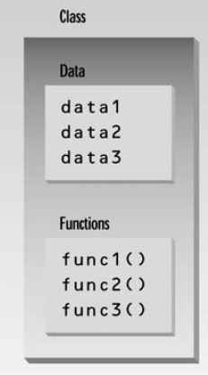
Class
A blueprint (design)
Out of a blueprint, a builder can make a house, out of a class, a programmer can create an object
One blueprint can be reused many times to make many houses, one class can be reused many times to make many objects
programmer-defined types
Each class has
Attributes (Data Members)
Set of functions to manipulate the data (member functions)
The nouns in a system specification help the C++ programmer determine the set of classes that will be used to create the objects that will work together to implement the system

Slide 19
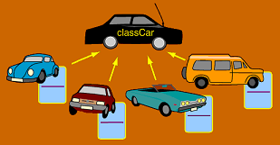
Object
An instance of a class
In terms of variables, class would be the type and an object would be the variable
objects

Slide 20
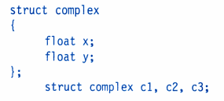
Structs vs Classes
The standard C does not allow the struct data type to be treated like built-in types
E.g., we cannot add two complex numbers
Structs do not permit data hiding
Structure members be directly accessed by the structure variables by any functions anywhere in the their scope

Slide 21
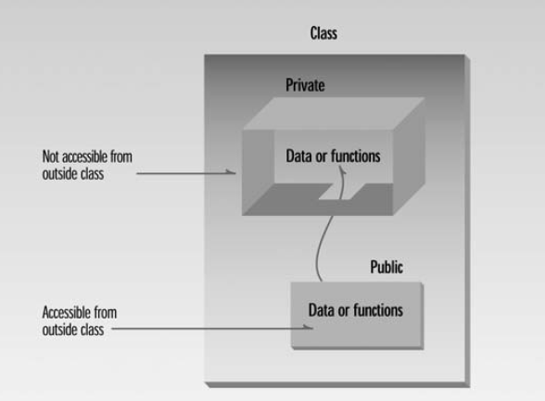
C++ Classes

Slide 22
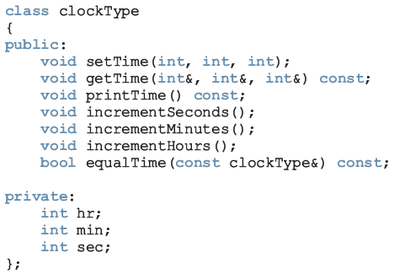
Defining a class in C++
Member functions
Prototypes only
Data members
simple variable declarations.
No initializations

Slide 23
Member access specifier

Slide 24
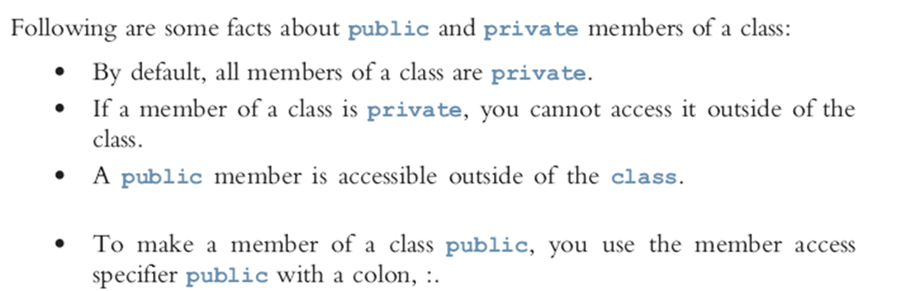

Slide 25

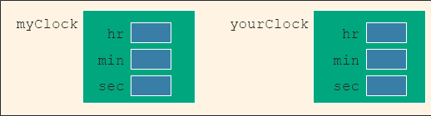
Creating an object
Any operation on data members can be done through functions only. Following is not allowed in main():
myClock.hr=1;
cin>>myClock.min;
cout<<myClock.sec;

Slide 26

Updating class data members using member functions

